Slide 1
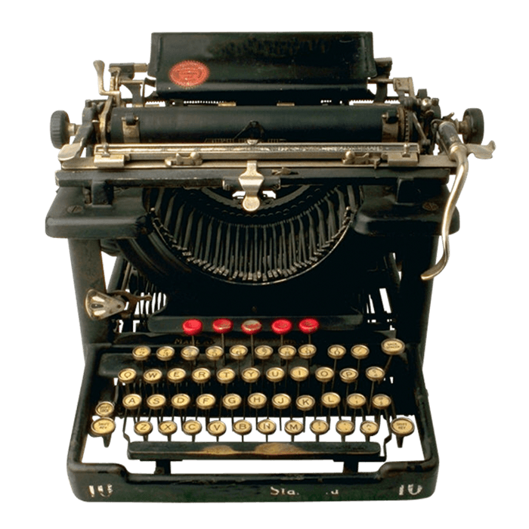

Slide 3
Defining Nonce
Number use once
Introduction to Nonce and Random Numbers
Nonce and random number generation are fundamental concepts in cryptography and cybersecurity. This presentation will explore the definition, importance, and characteristics of a nonce, as well as delve into the different methods of generating random numbers.

Slide 4
Introduction to Nonce and Random Numbers
Defining Nonce
Nonce and random number generation are fundamental concepts in cryptography and cybersecurity. This presentation will explore the definition, importance, and characteristics of a nonce, as well as delve into the different methods of generating random numbers.
Number use once

Slide 5
Defining Nonce
Number use once

Slide 6
Characteristics
Importance
Defining
In cryptography, a nonce is a unique number used only once in a communication. It's often random or pseudo-random, and sometimes includes a timestamp for better accuracy.

Slide 7
Characteristics
Importance
Defining
Unique messages: Nonces prevent replay attacks by ensuring each message is unique.
Authentication: They can help verify sender identity and prevent impersonation.
Stronger encryption: Nonces contribute to randomness, making encryption harder to crack.

Slide 8
Characteristics
Importance
Defining
Nonces: unique, unpredictable, never reused, efficiently generated for strong crypto.

Slide 9
Random Numbers
Characteristics
Importance
Defining
Nonces: unique, unpredictable, never reused, efficiently generated for strong crypto.

Slide 10
Generation

Slide 11
Entropy Collection
Gather entropy from various sources, such as system events, mouse movements, and keyboard inputs.
Generation

Slide 12


Entropy Collection
Gather entropy from various sources, such as system events, mouse movements, and keyboard inputs.

Slide 13
Entropy Collection
Gather entropy from various sources, such as system events, mouse movements, and keyboard inputs.
8
7
6
5
4
3
2
1
A B C D E F G H

Slide 14
8
7
6
5
4
3
2
1
A B C D E F G H

Slide 15
8
7
6
5
4
3
2
1
D4
A B C D E F G H

Slide 16
D4
8
7
6
5
4
3
2
1
A B C D E F G H

Slide 17
8
7
6
5
4
3
2
1
7B 6E 4A 2C 2E
A B C D E F G H

Slide 18
True random number generation using lava lamp
By Cloudflare - Lavarand
7B 6E 4A 2C 2E
8
7
6
5
4
3
2
1
A B C D E F G H

Slide 19
True random number generation using lava lamp
By Cloudflare - Lavarand

Slide 20
True random number generation using lava lamp
By Cloudflare - Lavarand

Slide 21
Pseudo-Random Number
Vs True-Random Number
Deterministic Generation
Efficiency and Speed
Weaknesses
PRNGs use mathematical algorithms to generate a sequence of numbers that appears random, but is actually deterministic and predictable if the initial state (seed) is known.
PRNGs are generally faster and more efficient than TRNGs, making them suitable for many applications where speed is a priority.
PRNGs can be vulnerable to attacks if the seed value is compromised, which can lead to the entire sequence of generated numbers being predictable.

Slide 22
Pseudo-Random Number
Vs True-Random Number
Deterministic Generation
Efficiency and Speed
Weaknesses
PRNGs use mathematical algorithms to generate a sequence of numbers that appears random, but is actually deterministic and predictable if the initial state (seed) is known.
PRNGs are generally faster and more efficient than TRNGs, making them suitable for many applications where speed is a priority.
PRNGs can be vulnerable to attacks if the seed value is compromised, which can lead to the entire sequence of generated numbers being predictable.

Slide 23
Pseudo-Random Number
Vs True-Random Number
Deterministic Generation
Efficiency and Speed
Weaknesses
PRNGs use mathematical algorithms to generate a sequence of numbers that appears random, but is actually deterministic and predictable if the initial state (seed) is known.
PRNGs are generally faster and more efficient than TRNGs, making them suitable for many applications where speed is a priority.
PRNGs can be vulnerable to attacks if the seed value is compromised, which can lead to the entire sequence of generated numbers being predictable.

Slide 24
Pseudo-Random Number
Vs True-Random Number
Deterministic Generation
Efficiency and Speed
Weaknesses
PRNGs use mathematical algorithms to generate a sequence of numbers that appears random, but is actually deterministic and predictable if the initial state (seed) is known.
PRNGs are generally faster and more efficient than TRNGs, making them suitable for many applications where speed is a priority.
PRNGs can be vulnerable to attacks if the seed value is compromised, which can lead to the entire sequence of generated numbers being predictable.

Slide 25



Pseudo-Random Number
Vs True-Random Number
Conclusion and Key Takeaways
Nonce Importance
Random Number Generation
Cryptographic Security
Nonces are crucial for ensuring the integrity and security of cryptographic communications.
Understanding the characteristics and generation of nonces and random numbers is fundamental to maintaining strong cryptographic security.
Proper generation of random numbers, using either PRNGs or TRNGs, is essential for cryptographic applications.
Deterministic Generation
Efficiency and Speed
Weaknesses
PRNGs use mathematical algorithms to generate a sequence of numbers that appears random, but is actually deterministic and predictable if the initial state (seed) is known.
PRNGs are generally faster and more efficient than TRNGs, making them suitable for many applications where speed is a priority.
PRNGs can be vulnerable to attacks if the seed value is compromised, which can lead to the entire sequence of generated numbers being predictable.

Slide 26
Conclusion and Key Takeaways
Nonce Importance
Random Number Generation
Cryptographic Security
Nonces are crucial for ensuring the integrity and security of cryptographic communications.
Understanding the characteristics and generation of nonces and random numbers is fundamental to maintaining strong cryptographic security.
Proper generation of random numbers, using either PRNGs or TRNGs, is essential for cryptographic applications.

